Slide 1
Solving Problems by Searching
Artificial Intelligence: A Modern Approach, 3rd Edition
Stuart Russell and Peter Norvig

Slide 2
Outline…
Problem-Solving Agents
Problem Types
Problem Formulation
Example Problems
Basic Search Algorithms

Slide 3
What’s a Problem?...
When Faced With an Issue, an Agent Acts by FIRST Establishing Goals and THEN Considering Some Sequence of Actions That Might Achieve Those Goals…
A Problem is a Goal and a Set of Means for Achieving It…
A Search is the Process of Exploring What the Means Can Do…
Ultimately We Show What the Search Can Do, How It Must Be Modified to Account for Adversaries, and What Its Limitations Are…

Slide 4
Simple Reflex Agents…
Simple Reflex Agents Are Unable to Plan Ahead…
They Are Limited In What They Can Do Because Their Actions Are Determined Only By the Current Percept…
They Have No Knowledge of What Their Actions Do Nor of What They Are Trying to Achieve…

Slide 5
Problem Solving Agents…
A Problem-Solving Agent Is a Goal-Based Agent…
Problem-Solving Agents Decide What To Do By Finding Sequences of Actions That Lead to Desirable States…
The Problem Type That Results From the Formulation Process Will Depend On the Knowledge Available to the Agent…That Is, Do They Know the Current State and the Outcomes of Actions…
Given Precise Definitions of Problems, It Is Relatively Straightforward to Construct a Search Process For Finding Solutions…

Slide 6
Goal Formulation…
Intelligent Agents Are Supposed to Act in Such a Way That the Environment Goes Through a Sequence of States That Maximizes the Performance Measure…
The Task Is Somewhat Simplified If the Agent Can Adopt a Goal and Aim to Satisfy It…
Goal Formulation, Based On the Current Situation, Is the First Step in Problem Solving…
Goals Help Organize Behavior By Limiting the Objectives That the Agent Is Trying to Achieve…
The Agent May Also Decide On Other Factors That Could Affect the Goal…

Slide 7
Problem Formulation…
Problem Formulation Is the Process of Deciding What Actions and States to Consider…
Problem Formulation Follows Goal Formulation…
The States We Consider Are Those States in Which the Goal Is Satisfied…
Actions Can Be Viewed As Causing Transitions Between States…
The Level of Detail of Each Action Must Also Be Considered…

Slide 8
Search Solution and Execution…
A Solution Is the Process of Looking for a Sequence of Actions Leading From the Initial State to a Goal State..
This Process of Looking for Such a Sequence of Action Is Called a Search…
A Search Algorithm Takes a Problem As Input and Returns a Solution in the Form of an Action Sequence…
A Search With Several Options of Unknown Value Can Decide What To Do By First Examining Different Possible Sequences of Actions That Lead to States of Known Value…It Can Then Choose the Best One…
Execution Is Carrying Out the Actions Recommended By the Search…

Slide 9
“Formulate, Search, Execute” Design…
The Agent Has a "Formulate, Search, Execute" Design…
Formulate a Goal and a Problem to Solve…
Search Sequence of Actions to Determine How Best to Solve the Problem...
Execute the Recommended Sequence, Removing Each Step As It Executes the Sequence…
Once the Solution Has Been Executed, the Agent Will Find a New Goal…

Slide 10
Problem Types – Part 1…
Single State Problem…
Simplest Case…
Deterministic As It Is Fully Observable…
Can Determine What State It Is In Now…That Is, the World Is Accessible…
Knows Exactly Which State It Will Be In After A Sequence of Actions…
Multiple State Problem…
Not Fully Accessible…
Agent Must Reason About SETS of States Instead of SINGLE States…

Slide 11
Problem Types – Part 2…
Contingency Problem…
Nondeterministic and / or Partially Observable…
Senses DURING Execution…Exact Prediction Is Impossible…
Percepts Provide New Information About Current State…
Solution is a Tree or Policy…
Often Interleave Search and Execution…

Slide 12
Problem Types – Part 3…
Exploration Problem…
No Information About Effects of Its Actions…
Experiment and Gradually Discover What Actions Do and What States Exist…
Conformant Problem…
Agent May Be in Any number of States…
Solution (if any) is a Sequence of Actions…

Slide 13
Example of Problem Solving Agent: Romania…
Agent is in the City of Arad, Romania…
Agent Has a Ticket to Fly Out of Bucharest the Following Day…
Ticket Is Nonrefundable…
Agent's Visa is About to Expire…
After Tomorrow, There Are No Seats Available for Six Weeks…
Agent's Performance Measure Now Contains Other Factors Besides the Cost of the Ticket...

Slide 14
Example of Problem Solving Agent: Romania…
Formulate Goal:
Be In Bucharest…
Formulate Problem:
States: Various Cities…
Actions: Drive Between Cities…
Find Solution:
Sequence of Cities; e.g., Arad, Sibiu, Fagaras, Bucharest..

Slide 15
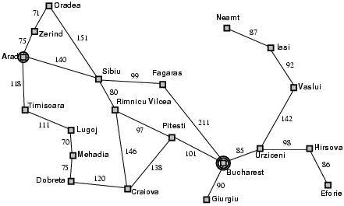
Example of Problem Solving Agent: Romania…

Slide 16
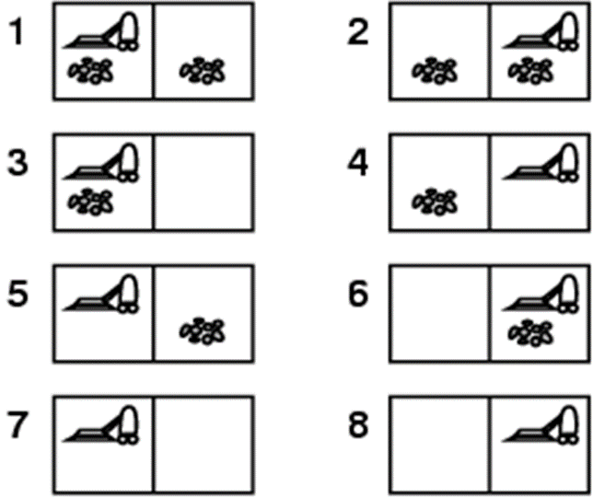
Example: Vacuum World…
Single-State…Start in #5…
Solution?...

Slide 17
Example: Vacuum World…
Single-State…Start in #5…
Solution?...
[Right, Remove]

Slide 18
Example: Vacuum World…
Multiple State or Conformant…
Start in {1,2,3,4,5,6,7,8}, Right Goes to {2,4,6,8} , Left Goes to {1,3,5,7}, Remove Goes to {5, 4, 7, 8}
Solution?

Slide 19
Example: Vacuum World…
Multiple State or Conformant…
Start in {1,2,3,4,5,6,7,8}, Right Goes to {2,4,6,8} , Left Goes to {1,3,5,7}, Remove Goes to {5, 4, 7, 8}
Solution?
[Right, Remove, Left, Remove]

Slide 20
Example: Vacuum World…
Contingency…
Nondeterministic: “Remove” May Dirty a Clean Carpet
Partially Observable: Location, Dirt at Current Location.
Percept: [L, Clean], i.e., Start In #5 Or #7
Solution?

Slide 21
Example: Vacuum World…
Contingency…
Nondeterministic: Remove May Dirty a Clean Carpet
Partially Observable: Location, Dirt at Current Location.
Percept: [L, Clean], i.e., Start in #5 Or #7
Solution?...
[Right, If Dirt Then Remove]

Slide 22
Well-Defined Problems – Part 1…
A Problem is Really a Collection of Information That the Agent Will Use to Decide What to Do…
Basic Elements of a Problem Definition Are the States and Actions…
Initial State: the State that the Agent Knows Itself To Be In…
Set of Possible Actions Available to the Agent. ..
Operator: Is Used to Denote the Description of an Action in Terms of Which State Will Be Reached By Carrying Out the Action in a Particular State…
State Space of the Problem: Set of All States Reachable From the Initial State By Any Sequence of Actions…
A Path in the State Space is Simply Any Sequence of Actions Leading From One State to Another. ..

Slide 23
Well-Defined Problems – Part 2…
The Goal Test Can Apply To A Single State Description To Determine If It Is A Goal State…
If There Is An Explicit Set of Possible Goal States, the Test Simply Checks To See If We Have Reached One of Them…
Sometimes the Goal Is Implicit (i.e., Specified By An Abstract Property) Rather Than Explicit…
For Example, In Chess, the Goal Is To Reach A State Called "Checkmate," Where the Opponent's King Can Be Captured On the Next Move No Matter What the Opponent Does…
It May Be the Case That One Solution Is Preferable To Another, Even Though They Both Reach the Goal…For Example, One Path Has Fewer Or Less Costly Actions…
Path Cost Assigns A Cost To A Path…the Sum of the Costs of the Individual Actions Along the Path…
Ultimately, a Problem is Defined By the Initial State (or “Set of States” in a Multiple States Problem), the Operator Set, the Goal Test, and Path Cost…

Slide 24
Measuring Search Effectiveness…
Complete: Is the Search Guaranteed to Find a Solution When There Is One?...
Time: How Long Does It Take to Find a Solution
Space: How Much Memory Does It Need to Perform the Search?...
Optimal: Does the Strategy Find the Highest-Quality Solution When There Are Several Different Solutions?...
Cost Effective: What Is the Search Cost (Time and Memory) Required To Find a Solution?...To Find the BEST Solution?...

Slide 25
Abstraction…
Removing Detail From a Description is Referred to as Abstraction…
For Example:
“Driving a Car” is an Abstraction of All the Detail That Goes Into Actually Driving a Car…
“Taking a Class” is an Abstraction of All the Detail That Goes Into Actually Taking a Class…

Slide 26
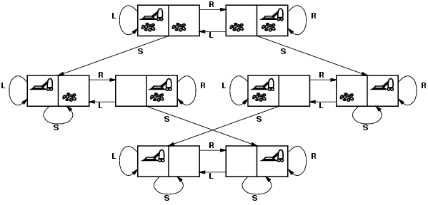
Vacuum World State Space Graph…
States?...
Actions?...
Goal Test?...
Path Cost?...

Slide 27
Vacuum World State Space Graph…
States?...
Dirt, Clean, and Robot Location…
Actions?...
Left, Right, Remove…
Goal Test?...
No Dirt at All Locations…
Path Cost?...
1 Per Action…Move…That Is, the Path Cost is the Length of the Path…

Slide 28
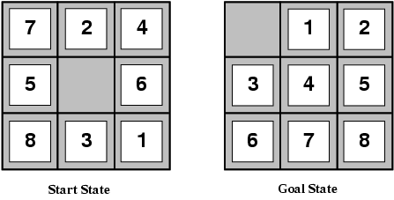
Example: the 8-Puzzle…
States?...
Actions?...
Goal Test?...
Path Cost?...

Slide 29
Example: the 8-Puzzle…
States?...
Locations of Tiles
Actions?...
Move Blank Left, Right, Up, Down
Goal Test?...
Tiles in Numeric Order…
Path Cost?...
1 Per Move…That Is, the Path Cost is the Length of the Path…

Slide 30
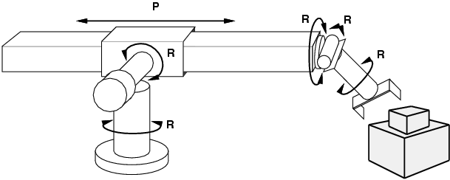
Example: Robotic Assembly…
States?...
Actions?...
Goal Test?...
Path Cost?...

Slide 31
Example: Robotic Assembly…
States?...
Real-valued Coordinates of Robot Joint Angles, Parts of the Object To Be Assembled…
Actions?...
Continuous Motions of Robot Joints…
Goal Test?...
Complete Assembly…
Path Cost?...
Time To Execute…

Slide 32
Real World Problems…
Route Finding: Computer Networks, Automated Travel Advisory Systems, Airline Travel Planning…
Touring, Travelling Salesperson: Visit Every City At Least Once and Have the Shortest Tour…Similar To Route Finding But State Space Must Record More Information…
Robot Navigation: Generalization of Route Finding…Rather Than a Discrete Set of Routes, a Robot Can Move in a Continuous Space With (In Principle) an Infinite Set of Possible Actions and States…When the Robot Has Arms and Legs That Must Also Be Controlled and Now It Becomes a Multi-Dimensional Issue, Including Dealing With Errors in Sensor Readings and Motor Controls…
Automatic Assembly Sequencing: Find an Order In Which to Assemble the Parts of Some Object Economically…If the Wrong Order is Chosen, There Will Be No Way to Add Some Part Later in the Sequence Without Undoing Some of the Work Already Done…

Slide 33
Searching for Solutions…
Now That We Have Defined a Problem, We Need to Come Up With a Solution!...
To Do This, We Must “Expand the Current State”…
We Do This By Applying Operators to the Current State to Generate New Sets of States…
We Test the Current State Against the “Goal State”…
If It Is NOT the “Goal State”, the Next Sequence is Tried…
Think of a Search Tree…

Slide 34
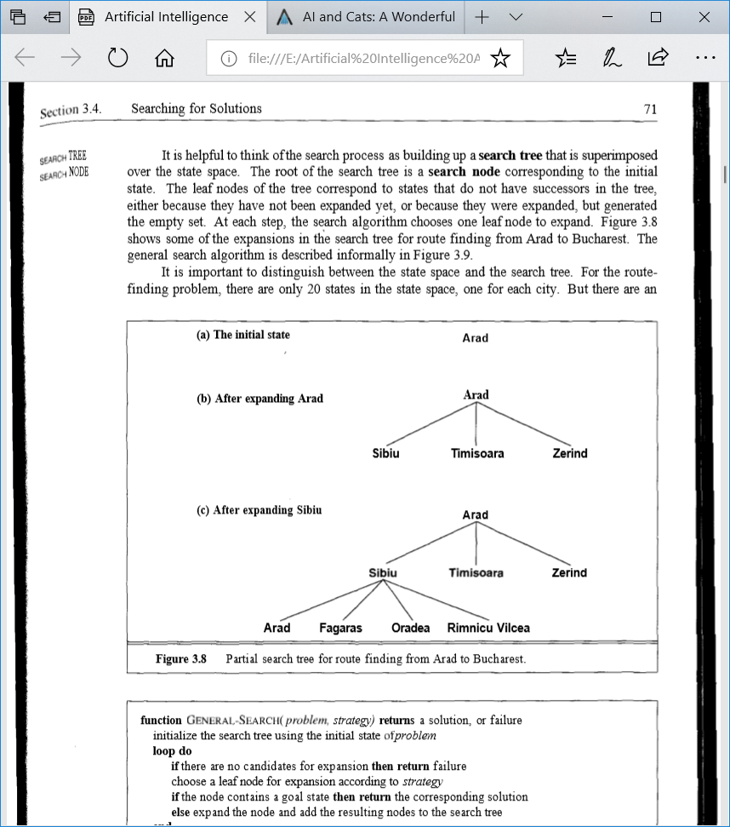
Search Tree for Our Trip to Bucharest…

Slide 35
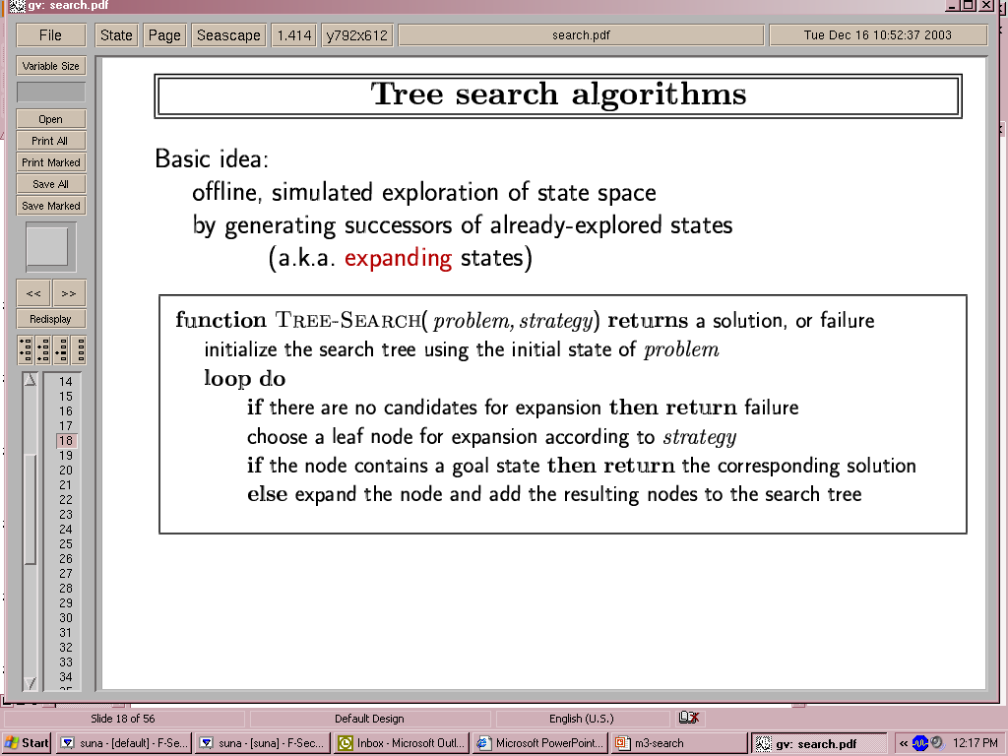
General Tree Search Algorithms…

Slide 36
States vs. Nodes…
A Node Is a Data Structure Used to Represent the Search Tree For a Particular Problem Instance as Generated By a Particular Algorithm…
A State Represents a Configuration or Set of Configurations…
Nodes Have Depths and Parents…States Do Not…
It Is Possible For Two Different Nodes to Contain the Same State, If That State Is Generated Via Two Different Sequences of Actions…
The Expand Function Calculates Each Component of the Node It Generates…
The Fringe Or Frontier Is the Collection of Nodes Waiting To Be Expanded…
Could Be Computationally Expensive As the Function Might Have To Look At Every Element of the Set To Choose the Best One…
The Collection of Nodes Is Implemented As A Queue…

Slide 37
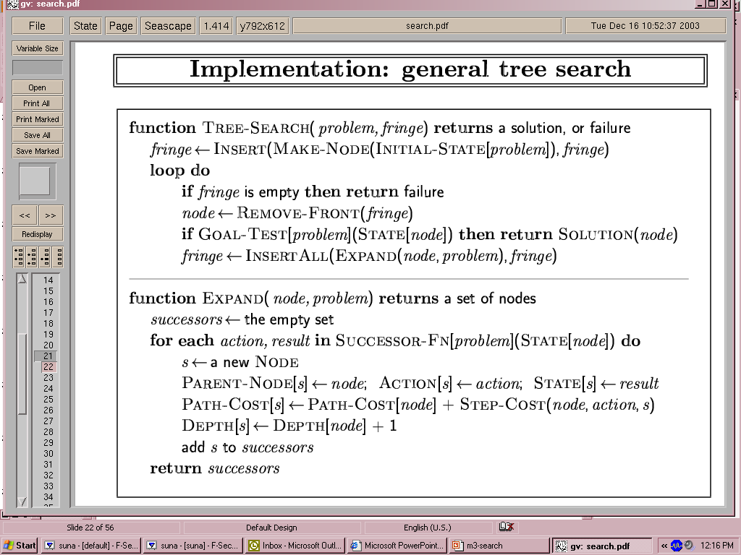
Expand Tree Search Algorithm…

Slide 38
Search Strategies…
A Search Strategy Is Defined By Picking the Order of Node Expansion…
Strategies Are Evaluated Along the Following Dimensions:
Completeness: Does It Always Find A Solution If One Exists?...
Time Complexity: How Long Does It Take to Find a Solution?...Number of Nodes Generated…
Space Complexity: How Much Memory Does It Need to Perform the Search?...Maximum Number of Nodes In Memory…
Optimality: How Do We Balance “Highest Quality” vs. “Least-Cost” Solutions?...

Slide 39
Uninformed or Blind Search Strategies…
Has No Information About the Number of Steps or the Path Cost From the Current State to the Goal State…
Uses Only the Information Available In the Problem Definition…
Strategies Distinguished by the Order in Which Nodes Are Expanded…
They Are:
Breadth-First Search…
Uniform-Cost Search…
Depth-First Search…
Depth-Limited Search…
Iterative Deepening Search…

Slide 40
Breadth-First Search…
Simplest Strategy…
Root Node Is Expanded First…Then All Nodes Generated By the Root Node Are Expanded Next, and Then Their Successors, and So On…
All the Nodes At A Given Depth “D” In the Search Tree Are Expanded Before the Nodes At the Next Depth…
Very Systematic Strategy…It Considers All the Paths of Length 1 First, Then All Those of Length 2, and So On…
If There Is a Solution, Breadth-First Search Is Guaranteed To Find It…
If There Are Several Solutions, Breadth-First Search Will Always Find the Shallowest Goal State First...

Slide 41
Properties of Breadth-First Search…
Complete...Yes…
Optimal...Yes…If Cost = 1 Per Step…
Time...Large Based on the Number of Nodes…
Space...All Nodes Must Be Maintained in Memory…
Space Is the Biggest Problem (More Than Time)…

Slide 42
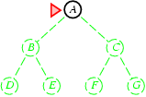
Breadth-First Search…
Expand Shallowest Unexpanded Node…
Implementation:
Fringe Is A FIFO Queue, I.E., New Successors Go At End…

Slide 43
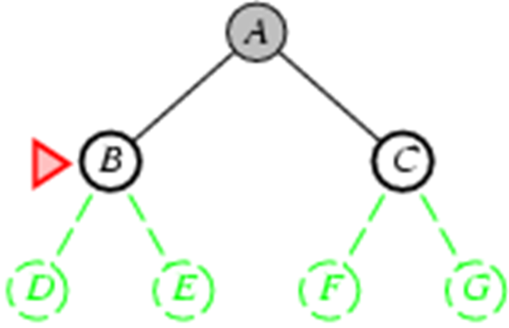
Breadth-First Search…
Expand Shallowest Unexpanded Node…
Implementation:
Fringe Is A FIFO Queue, I.E., New Successors Go At End…

Slide 44
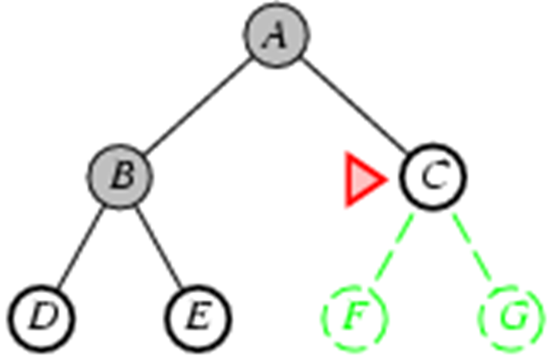
Breadth-First Search…
Expand Shallowest Unexpanded Node…
Implementation:
Fringe Is A FIFO Queue, I.E., New Successors Go At End…

Slide 45
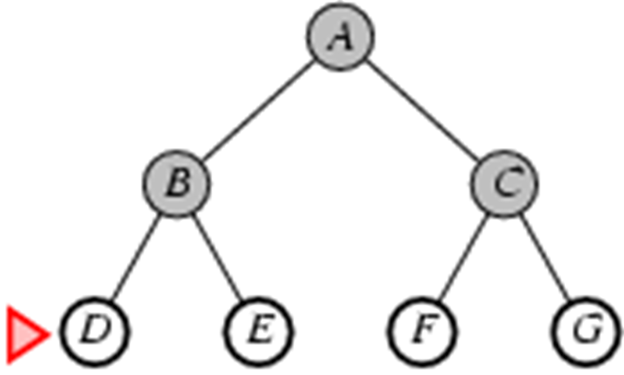
Breadth-First Search…
Expand Shallowest Unexpanded Node…
Implementation:
Fringe Is A FIFO Queue, I.E., New Successors Go At End…

Slide 46
Uniform-Cost Search…
Expand Least-Cost Unexpanded Node…
Any Solution Found After the First Is More Expensive…
Equivalent To Breadth-First If Step Costs All Equal…
Complete...Yes…
Time...Better…# of Nodes For Optimal Solution…Cost of the Optimal Solution…
Space...Only Expand Nodes for Optimum Solution…
Optimal...Yes – Nodes Expanded In Increasing Order of Cost…

Slide 47
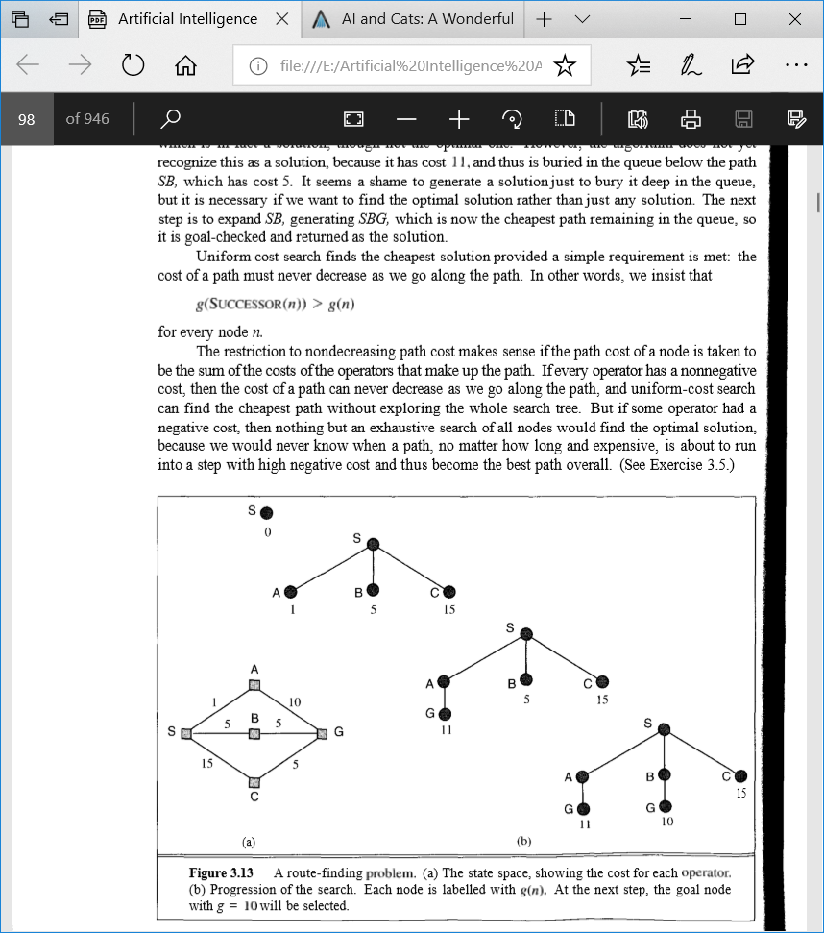
Uniform-Cost Search…
First Expand the Initial State, Yielding Paths To A, B, and C…
the Path To A Is Cheapest So It Is Expanded Next, Generating the Path SAG…
This is a Solution But Not the Optimal One…
To Find the Optimal Solution the Next Step Is To Expand SB, Generating SBG…
This is the Cheapest Path Remaining (C is 15)…
SBG Is Goal-checked and Returned As the Solution…

Slide 48
Depth-First Search…
Always Expands One of the Nodes At the Deepest Level of the Tree…
Only When the Search Hits A Dead End (A Non-Goal Node With No Expansion) Does the Search Go Back and Expand Nodes At Shallower Levels…
Has Very Modest Memory Requirements…It Needs To Store Only A Single Path From the Root To A Leaf Node, Along With the Remaining Unexpanded Sibling Nodes For Each Node On the Path…

Slide 49
Depth-First Search…
Complete...No…Can Get “Stuck” Down the Wrong Path…
Time...Terrible If Many Levels…But If Solutions Are Dense, May Be Much Faster Than Breadth-First…
Space...Needs Lots of Linear Space…
Optimal...No…

Slide 50
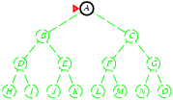
Depth-First Search…
Expand Deepest Unexpanded Node…
Implementation:
Fringe = LIFO Queue, I.E., Put Successors At Front…

Slide 51
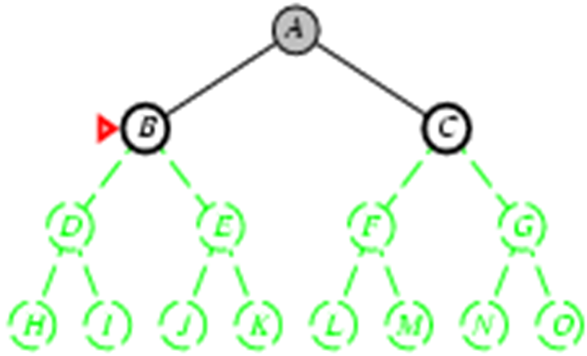
Depth-First Search…
Expand Deepest Unexpanded Node…
Implementation:
Fringe = LIFO Queue, I.E., Put Successors At Front…

Slide 52
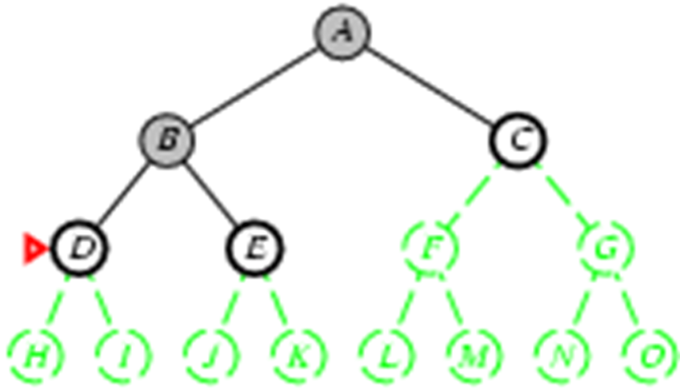
Depth-First Search…
Expand Deepest Unexpanded Node…
Implementation:
Fringe = LIFO Queue, I.E., Put Successors At Front…

Slide 53
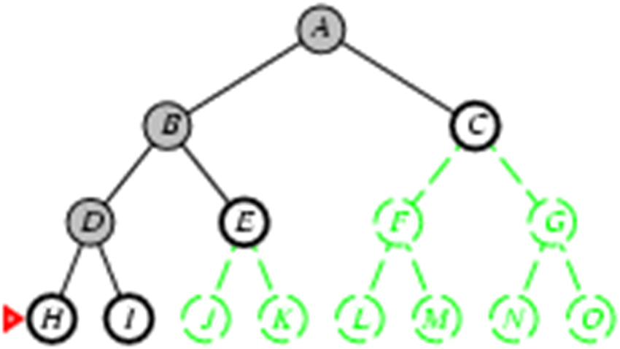
Depth-First Search…
Expand Deepest Unexpanded Node…
Implementation:
Fringe = LIFO Queue, I.E., Put Successors At Front…

Slide 54
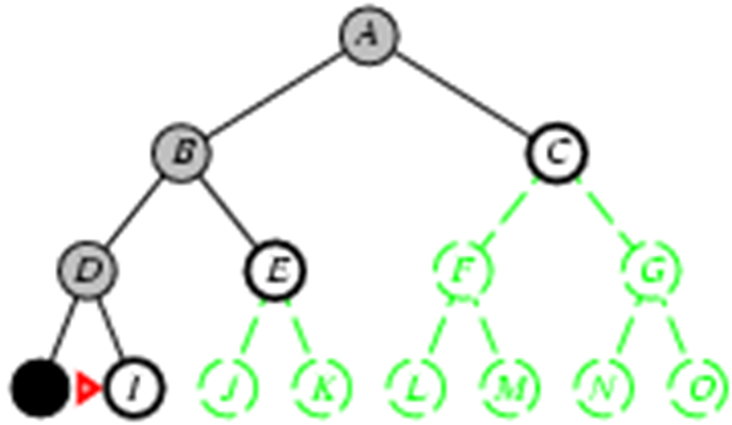
Depth-First Search…
Expand Deepest Unexpanded Node…
Implementation:
Fringe = LIFO Queue, I.E., Put Successors At Front…

Slide 55
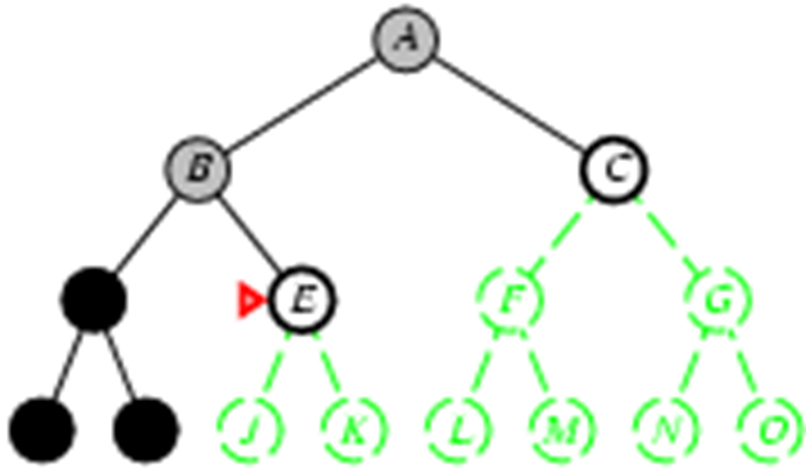
Depth-First Search…
Expand Deepest Unexpanded Node…
Implementation:
Fringe = LIFO Queue, I.E., Put Successors At Front…

Slide 56
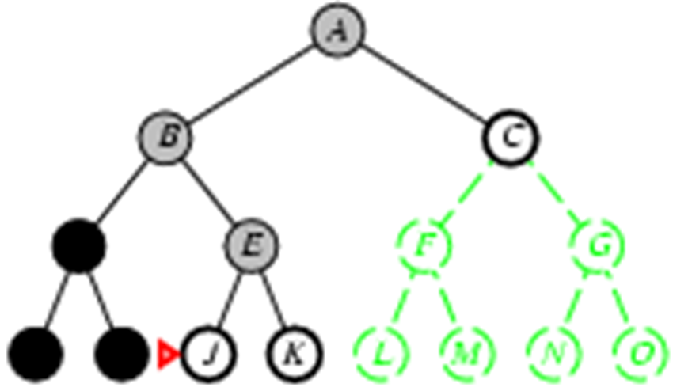
Depth-First Search…
Expand Deepest Unexpanded Node…
Implementation:
Fringe = LIFO Queue, I.E., Put Successors At Front…

Slide 57
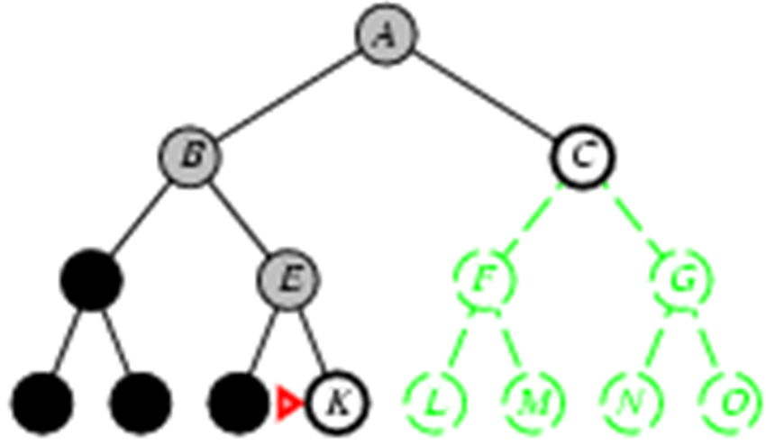
Depth-First Search…
Expand Deepest Unexpanded Node…
Implementation:
Fringe = LIFO Queue, I.E., Put Successors At Front…

Slide 58
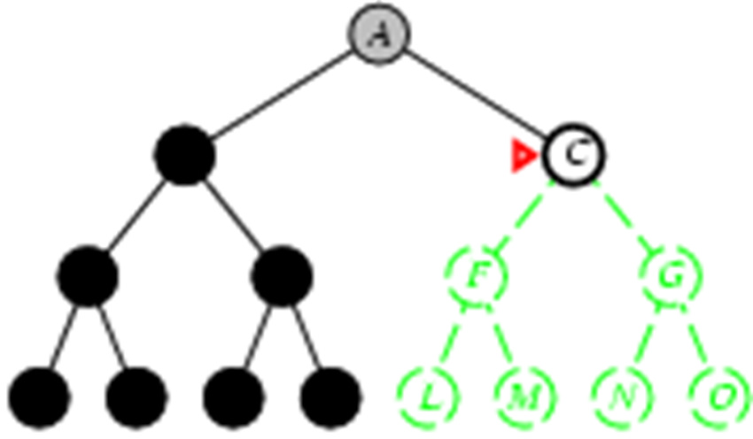
Depth-First Search…
Expand Deepest Unexpanded Node…
Implementation:
Fringe = LIFO Queue, I.E., Put Successors At Front…

Slide 59
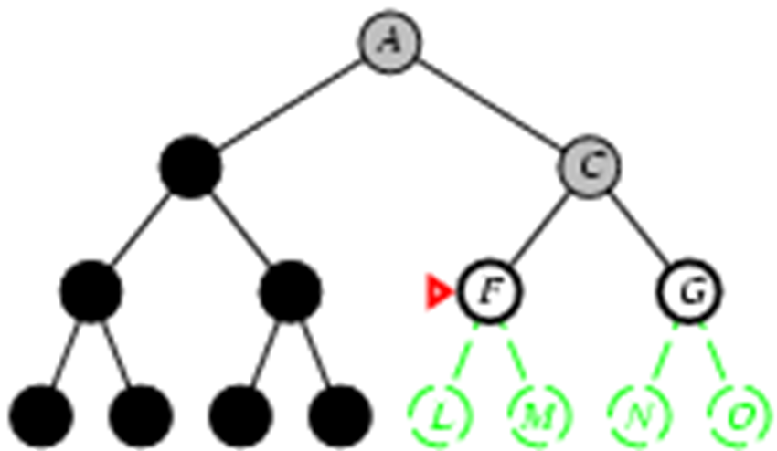
Depth-First Search…
Expand Deepest Unexpanded Node…
Implementation:
Fringe = LIFO Queue, I.E., Put Successors At Front…

Slide 60
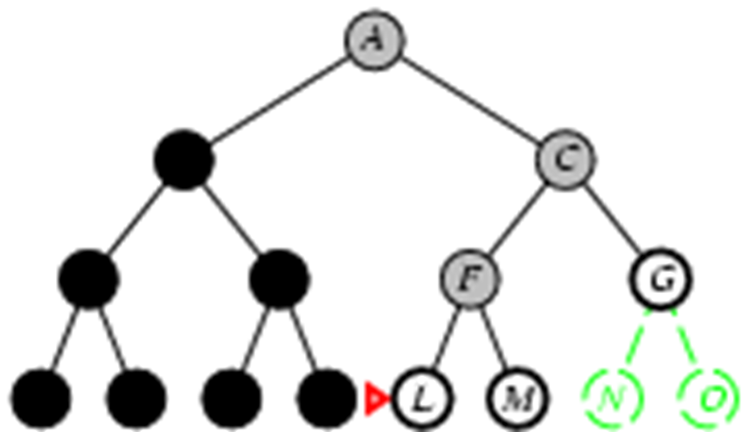
Depth-First Search…
Expand Deepest Unexpanded Node…
Implementation:
Fringe = LIFO Queue, I.E., Put Successors At Front…

Slide 61
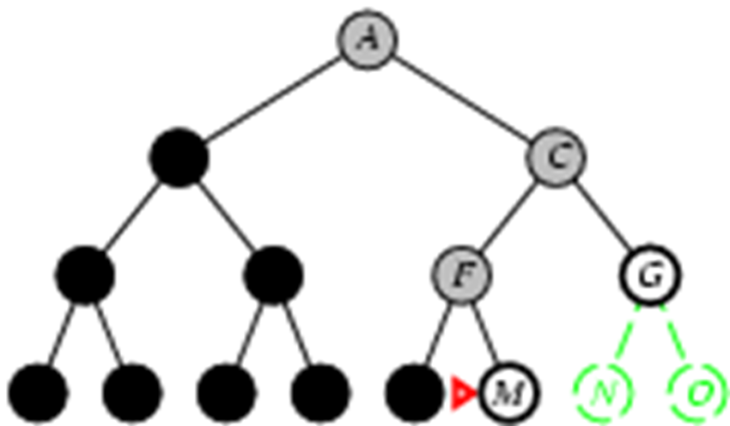
Depth-First Search…
Expand Deepest Unexpanded Node…
Implementation:
Fringe = LIFO Queue, I.E., Put Successors At Front…

Slide 62
Depth-Limited Search…
Avoids Pitfalls of Depth-First Search By Imposing A Cutoff On the Maximum Depth of A Path…
Cutoff Can Be Implemented With a Special Depth-Limited Search Algorithm or By Using the General Search Algorithm With Operators That Keep Track of the Depth…
Guaranteed To Find the Solution If It Exists…But NOT Guaranteed To Find the SHORTEST Solution First…
Biggest Issue Is Finding a Good Limit…
Depth-Limited Search Is Complete But Not Optimal….AND…
If We Choose A Depth Limit That Is Too Small, It May Not Even Be Complete!...
Time and Space Complexity Similar To Depth-First Search…

Slide 63
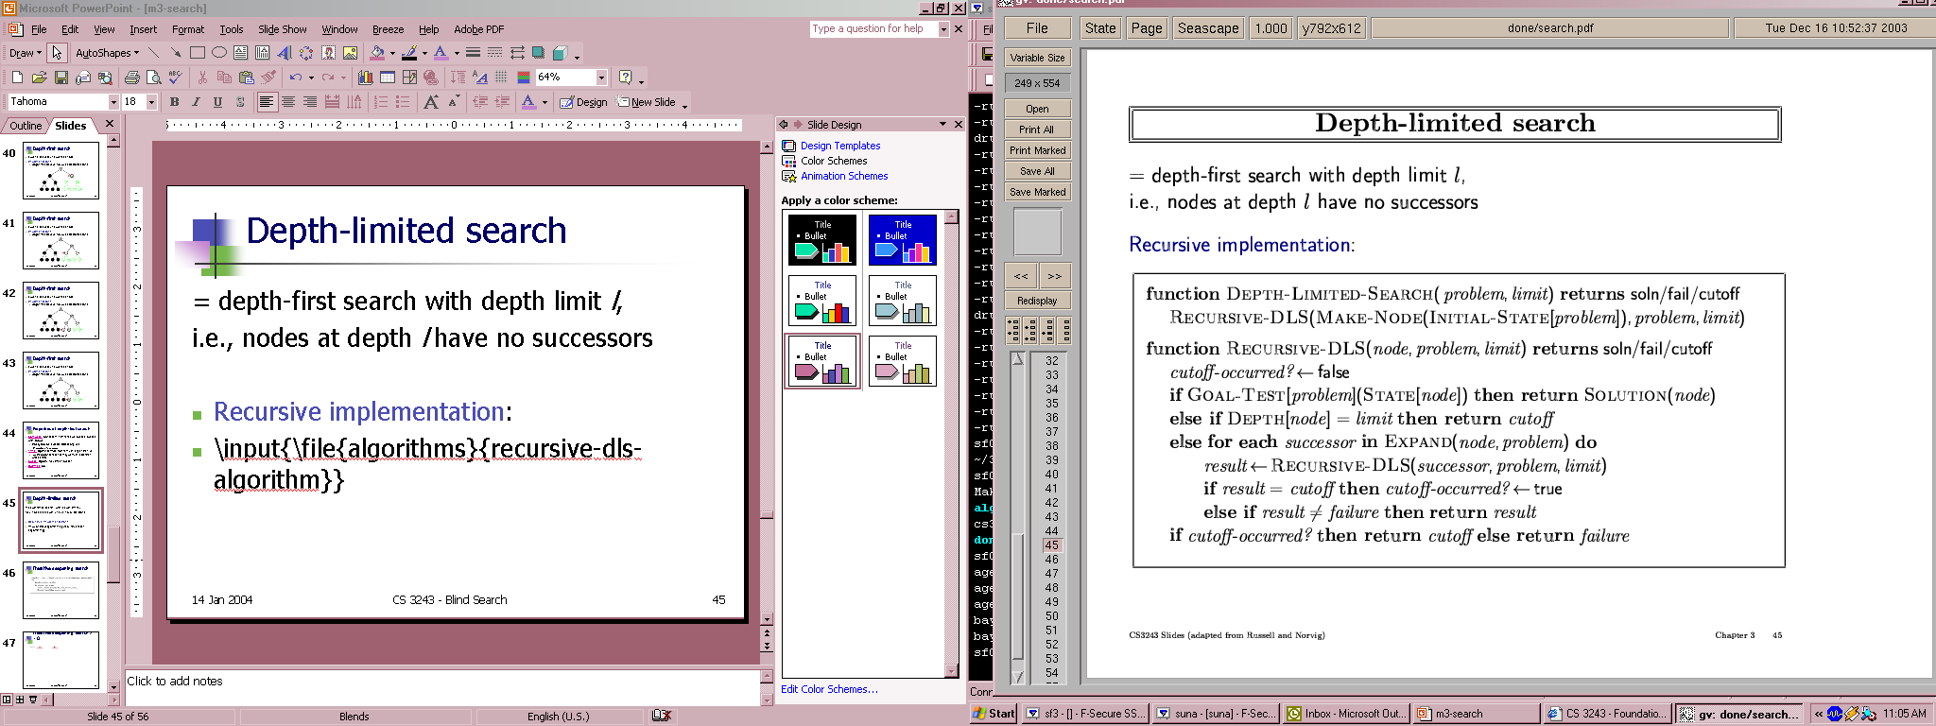
Depth-Limited Search…
= Depth-First Search With Depth Limit L,…
I.E., Nodes At Depth L Have No Successors…
Recursive Implementation:

Slide 64
Iterative Deepening Search…
For Most Problems, We Will Not Know A Good Depth Limit Until We Have Solved the Problem…
Sidesteps the Issue of Choosing the Best Depth Limit By Trying All Possible Depth Limits…”Student Program”…
Combines the Benefits of Depth-First and Breadth-First Search…
It Is Optimal (If Each Step Cost Is 1) and Complete, Like Breadth-First Search…
Has Only the Modest Memory Requirements of Depth-First Search…
Order of Expansion of States Is Similar To Breadth-First…Except That Some States Are Expanded Multiple Times….

Slide 65
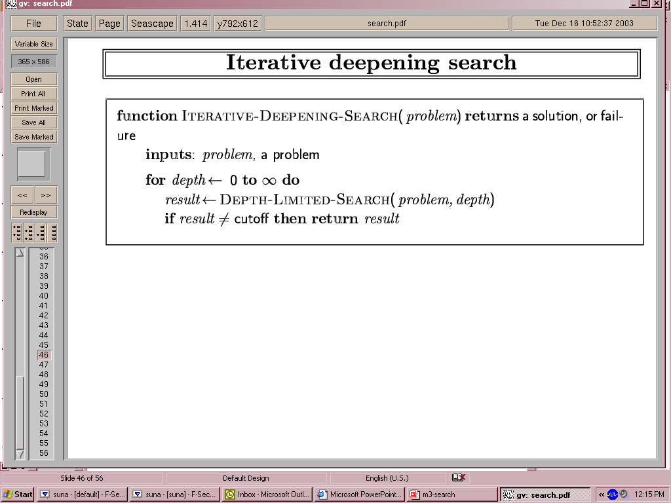
Iterative Deepening Search…

Slide 66
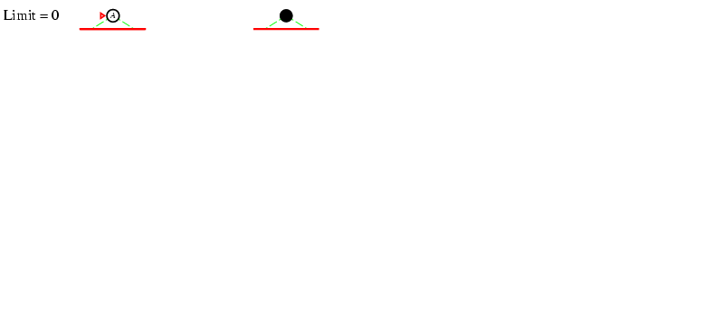
Iterative Deepening Search l =0…
the First Four Iterations of ITERATIVE-DEEPENING-SEARCH On A Binary Search Tree…

Slide 67
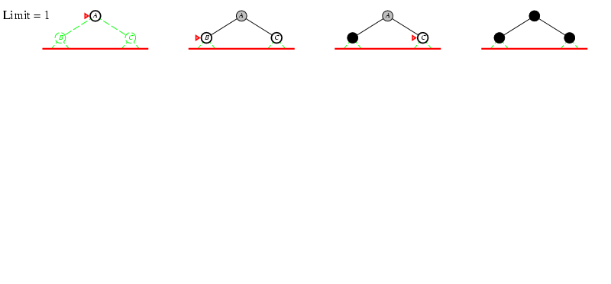
Iterative Deepening Search l =1…
the First Four Iterations of ITERATIVE-DEEPENING-SEARCH On A Binary Search Tree…

Slide 68
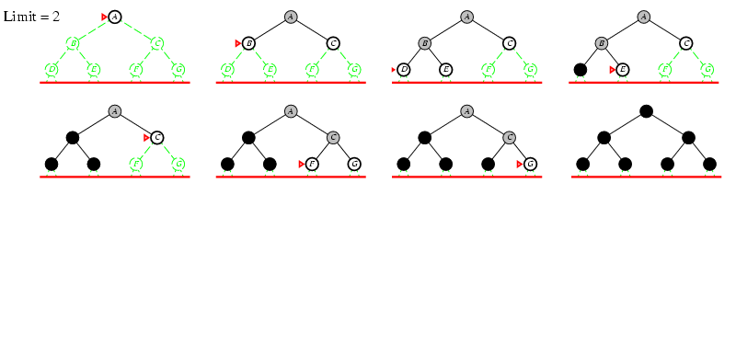
Iterative Deepening Search l =2…
the First Four Iterations of ITERATIVE-DEEPENING-SEARCH On A Binary Search Tree…

Slide 69
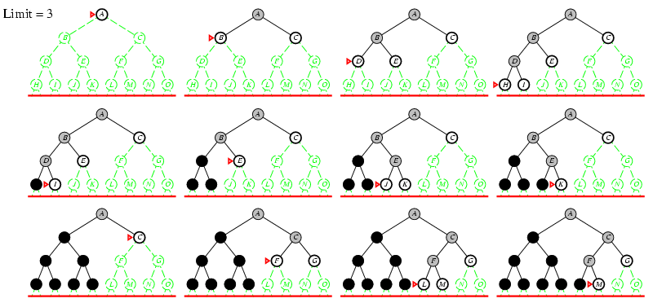
Iterative Deepening Search l =3…
the First Four Iterations of ITERATIVE-DEEPENING-SEARCH On A Binary Search Tree…

Slide 70
Bi-Directional Search…
Simultaneously Search Both Forward From the Initial State and Backward From the Goal…
You Then Stop When the Two Searches Meet In the Middle…
Best Case Is Forward and Backward Searches Each Have To Go Half Way…
Sounds Great In Theory…But Several Issues Need To Be Addressed:
What Does It Mean to Search Backward From the Goal?...Need to Generate Predecessors…
How Do You Handle IMPLICIT vs. EXPLICIT Goal States?...
Is There Actually a Half-Way Point?...

Slide 71
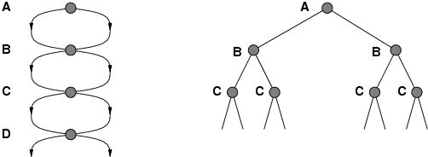
Bi-Directional Search…
Failure To Detect Repeated States Can Turn A Linear Problem Into An Exponential One!...

Slide 72
Questions…

